Slide 1
Heart Disease Prediction
Saravanakumar G
(EBSLEM0322454664)

Slide 2
Contents:
Introduction
Problem statement
Objective
Examples
Algorithms
Applications
Summary

Slide 3
Introduction
It is difficult to identify heart disease because of several contributory risk factors such as diabetes, high blood pressure, high cholesterol, abnormal pulse rate and many other factors.
The diagnosis of heart disease is a challenging task, which can offer automated prediction about the heart condition of patient so that further treatment can be made effective.

Slide 4
The diagnosis of heart disease is usually based on signs, symptoms of the patient.
The nature of heart disease is complex and hence, the disease must be handled carefully. Not doing so many affect the heart or cause premature death.

Slide 5
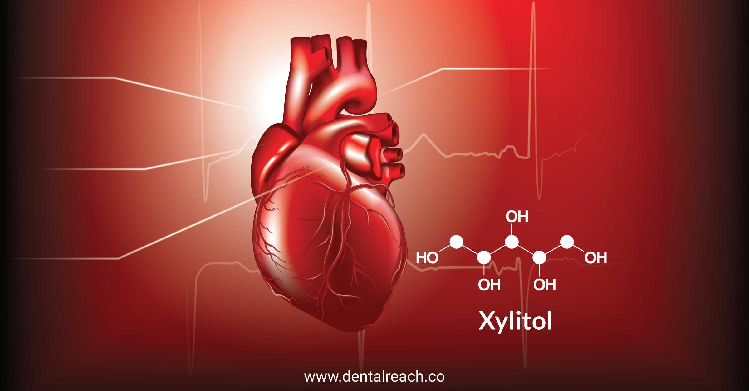
Problem statement
Heart disease prediction using machine learning algorithm.

Slide 6


Mandatory tools
Good laptop(above 4GB ram)
Anaconda Advanced version like 3.6
Jupiter lab or Note

Slide 7
Motivation
A major challenge facing healthcare organization is the provision of quality services at affordable cost.
Quality service employee diagnosing patients correctly and administering treatments that are effective.
Poor clinical decisions can lead to disastrous consequence which are therefore unacceptable

Slide 8
Hospitals must also minimize the cost of clinical tests.
They can achieve this result by employing appropriate computer based information and decision support system.

Slide 9
Objectives
The main objective of this research to develop a heart prediction systems, the system can discover and extract hidden knowledge associated with disease from heart data set.
Reduce the cost of medical test
Medical data set to assist in the prediction of the heart disease..

Slide 10
Machine learning
Machine learning (ML) is a type of artificial intelligence (AI) that allows software applications to become more accurate at predicting outcomes without being explicitly programmed to do so. Machine learning algorithms use historical data as input to predict new output values.

Slide 11
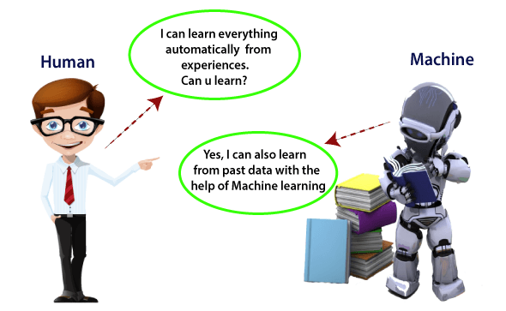

Slide 12
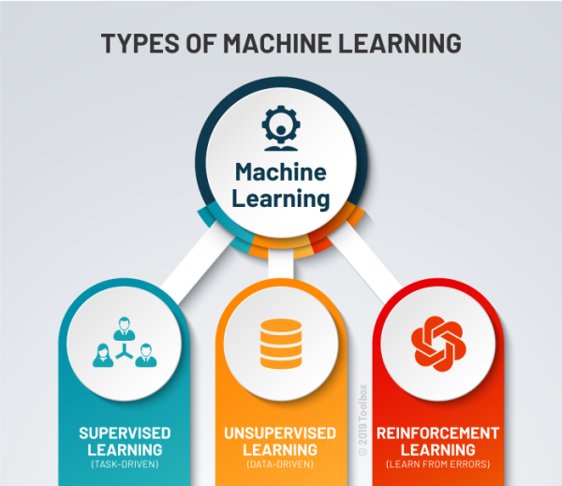

Slide 13
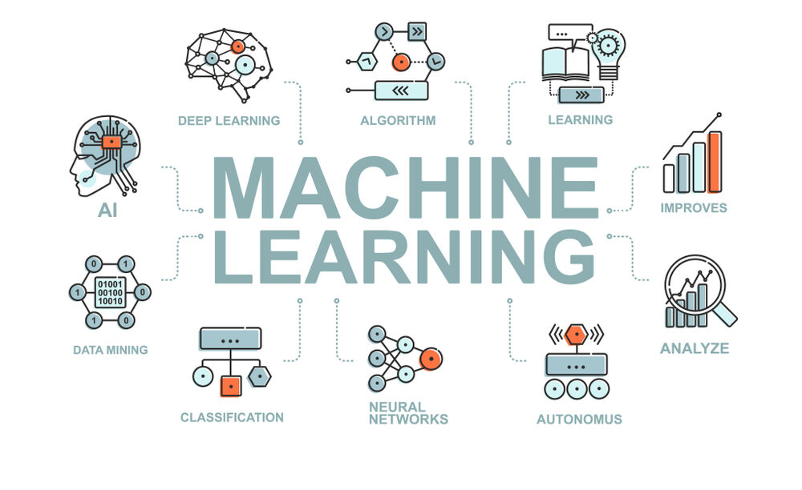

Slide 14
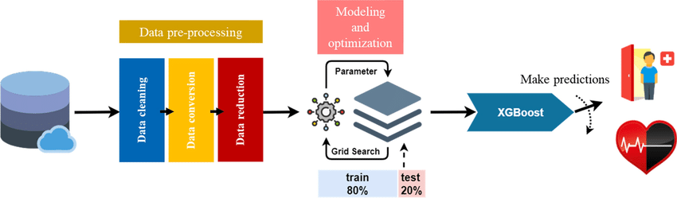
Proposed Model

Slide 15
Applications
Medical Institutions:
To teach medical students how the heart attack been measured or how to identify that the person is suffering from heart disease.
Hospitals:
To detect that is the person having heart disease or not

Slide 16
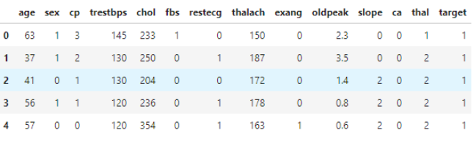
DATA

Slide 17
Exploratory Data Analysis
With EDA(Exploratory Data Analysis) we can able to understand our data better way.
In here we can find out how the data was distributed ,shape of data, relationship between variables.
The libraries used for EDA Pandas, Seaborn, Matplotlib,Sklearn

Slide 18
Algorithms
Logistic Regression
KNN
SVM
Naive Bayes
Decision Tree
Random Forest
XGBoost

Slide 19
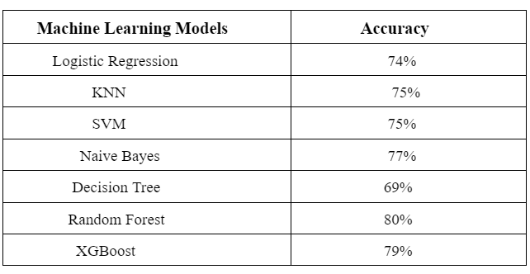
Predictions

Slide 20
From comparing the 7 models, we can conclude that Model 6: Random Forest yields the highest accuracy. With an accuracy of 80%. 🏆

Slide 21
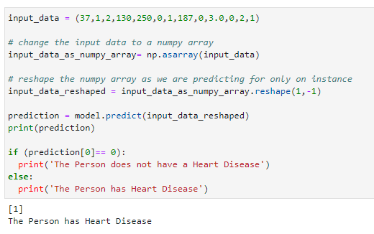

Slide 22


Slide 23
Thank you!

